Slide 1
GLOBAL WARMING.
NAME

Slide 2
DEFINITION
It is the persistent rise in global average surface temperature observed over the last half century.
Attributed to increasing in the concentration of greenhouse gases in the earth’s atmosphere.
They include Carbon (IV) Oxide, Methane, Ozone gas, Nitrous Oxide and Chlorofluorocarbons (CFCs)
The gases come from both human and natural sources.
Controversy exists based on the fact that the sources of contributing gases are both natural and human

Slide 3
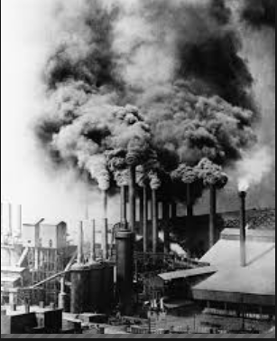
HISTORY
The debate on global warming originally during Industrial Revolution in 1858.

Slide 4
DEBATE
Controversy exists based on the fact that the sources of contributing gases are both natural and human.
The debate takes two perspectives.
Alleging that climate change is caused by human activities on the one hand (proponents).
Alleging natural processes as cause on the other (opponents)

Slide 5
DEBATE.
Proponents.
Opponents.

Slide 6
EVIDENCE OF PROPONENTS
The levels of greenhouse in the atmosphere have been shown to have increased.
The Carbon (IV) Oxide that is building the atmosphere is that of a distinct type.
Increase in the level of Carbon (IV) Oxide in the atmosphere.
The submerging of coastal lands and rising sea level due to the melting of ice caps
Abnormally high and sporadic rainfall in the equator

Slide 7
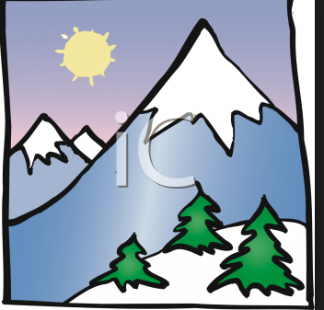
EVIDENCE OF PROPONENTS
Declining now caps of mountains in the equator region.

Slide 8
EVIDENCE OF OPPONENTS
Argue that saturation level of Carbon (IV) Oxide in the atmosphere has already been achieved.
Added Carbon (IV) Oxide is utilized by plants for photosynthesis process and some dissolves in water bodies.
Global cooling and warming are caused by the natural ‘solar forcing’ changes.
utilizing computer models they predict the global warming patterns in the past and future with notable success.

Slide 9
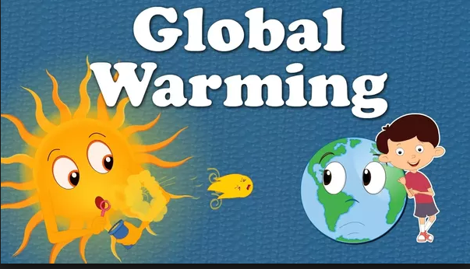
EVIDENCE OF OPPONENTS
Allege glaciers disappearance is also nothing new and has also been happening for thousands of years.

Slide 10
MITIGATION
Mitigation – reducing climate change – involves reducing the flow of heat-trapping greenhouse gases into the atmosphere.
This is by reducing sources of these gases for example, the burning of fossil fuels for electricity.
Enhancing the “sinks” that accumulate and store these gases (such as the oceans, forests and soil).
The goal of mitigation is to avoid significant human interference with the climate system, and “stabilize greenhouse gas levels in a timeframe sufficient to allow ecosystems to adapt naturally to climate change.
Ensuring that food production is not threatened and to enable economic development to proceed in a sustainable manner.

Slide 11
ADAPTATION
Adapting to life in a changing climate – involves adjusting to actual or expected future climate.
The goal is to reduce our vulnerability to the harmful effects of climate change.
It also encompasses making the most of any potential beneficial opportunities associated with climate change.
Throughout history, people and societies have adjusted to and coped with changes in climate and extremes with varying degrees of success.

